Slide 1

Codebasics SQL Challenge
Insights From 10 Ad-hoc Requests
By Kusuma S

Slide 2
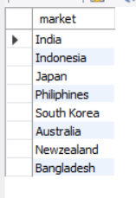
1. Provide the list of markets in which customer "Atliq Exclusive" operates its business in the APAC region.
In APAC region "AtliQ Exclusive" had markets in 8 countries

Slide 3

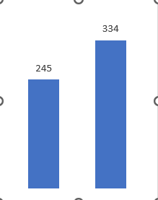
2. What is the percentage of unique product increase in 2021 vs. 2020? The final output contains these fields, unique_products_2020 unique_products_2021 percentage_chg
Percentage_change 36.32%
Insights
36% Demand & Production of products both increased by 2021
2020
2021
Unique_products

Slide 4
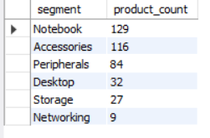
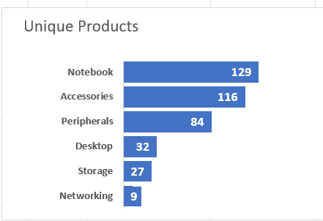
3. Provide a report with all the unique product counts for each segment and sort them in descending order of
product counts. The final output contains 2 fields, segment product_count
Unique Product Counts for each segment
17%
Insights
Segments: notebooks , accessories, peripherals are showing significant manufacturing growth as compared to desktop , storage , networking .
Notebooks , accessories, peripherals contributes 83% of the overall manufactured product.
Desktop , storage , networking contributes 17% of the overall manufactured product.

Slide 5
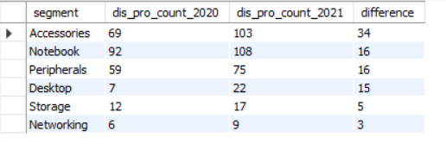
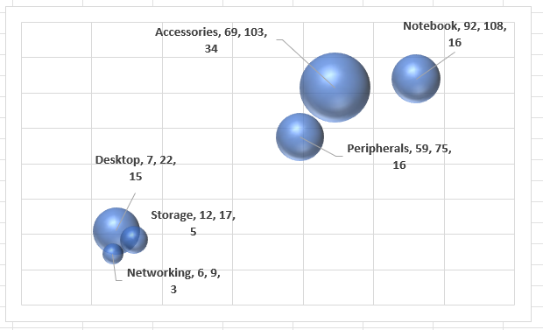
4. Follow-up: Which segment had the most increase in unique products in 2021 vs 2020? The final output contains these fields, segment product_count_2020 product_count_2021 difference
Unique Product difference per segment from 2020 to 2021
Insights
Accessories had the highest comparative increase in production with 34 new products
Storage & networking experiencing slower production growth than other segments with few new products

Slide 6
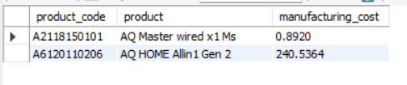
5 . Get the products that have the highest and lowest manufacturing costs. The final output should contain these fields, product_code product manufacturing_cost
Products with highest & lowest Manufacturing costs
cost
Product
Segment
$ 240.54
AQ HOME Allin1 Gen 2
Personal Desktop
$ 0.89
AQ Master wired x1 Ms
Mouse
Highest
Lowest
Insights
Highest Manufacturing Cost : Personal Desktop : AQ HOME Allin1 Gen 2 .
Lowest Manufacturing Cost : Mouse: AQ Master wired x1 Ms

Slide 7
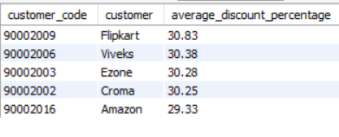
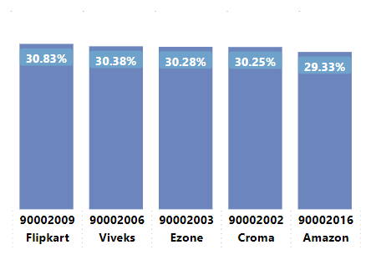
6. Generate a report which contains the top 5 customers who received an average high pre_invoice_discount_pct for the fiscal year 2021 and in the Indian market. The final output contains these fields, customer_code customer average_discount_percentage
Insights
Largest average pre_invoice_discount was given to Filpkart
Least average pre_invoice_discount was given to Amazon

Slide 8
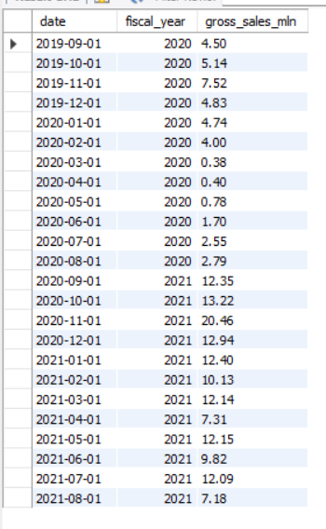

7. Get the complete report of the Gross sales amount for the customer “Atliq Exclusive” for each month. This analysis helps to get an idea of low and high-performing months and take strategic decisions. The final report contains these columns: Month Year Gross sales Amount
Total gross_sales (M)
181.52 M
56.67%
21.67%
78.33%
FY2020
FY2021
39.33 M
142.19 M
Insights
78.33 % Total Sales figure in fy2021
56.67 % sales increased from fy2020 to fy2021

Slide 9
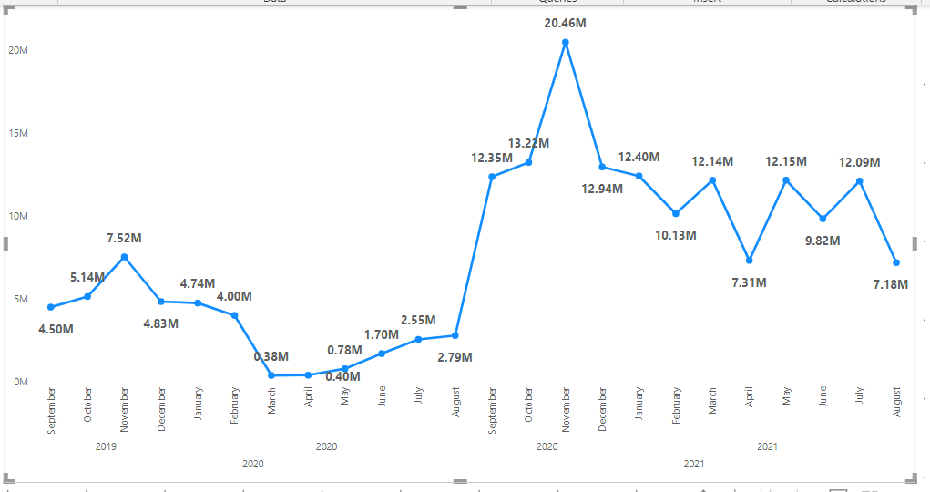

Slide 10
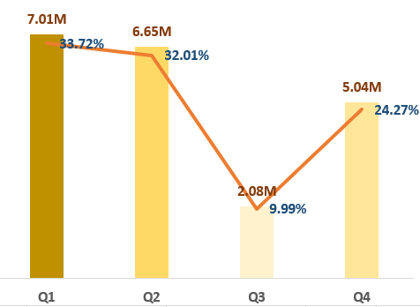
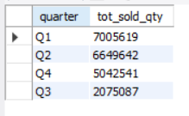
8. In which quarter of 2020, got the maximum total_sold_quantity? The final output contains these fields sorted by the total_sold_quantity, Quarter total_sold_quantity
Insights
Q1 had the most units sold overall ,while Q3 with the fewest or least products sold
Quarter 1 shows approximately 33.72% of the total sold quantity of FY2020
Quarter 4 shows approximately 24.27% of the total sold quantity of FY2020

Slide 11
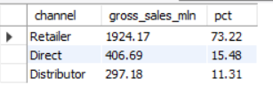
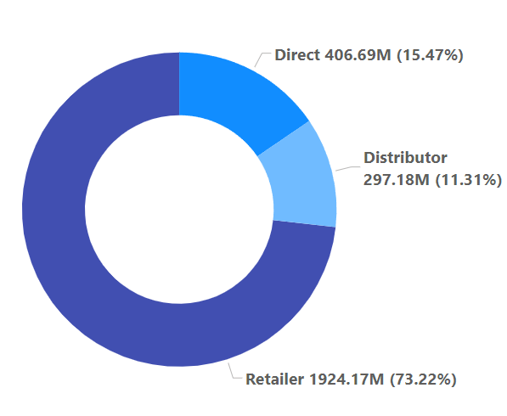
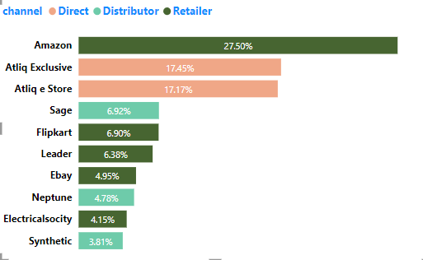
9. Which channel helped to bring more gross sales in the fiscal year 2021 and the percentage of contribution? The final output contains these fields, channel gross_sales_mln percentage
Insights
Channel “Retailer” helped to bring maximum sales to the company with 73.22% as the contribution percentage
“Distributor” makes least contribution with 11.31%

Slide 12
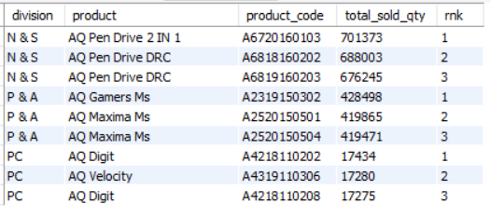
10. Get the Top 3 products in each division that have a high total_sold_quantity in the fiscal_year 2021? The final output contains these fields, division product_code codebasics.io product total_sold_quantity rank_order
Insights
Every division has a product with different variants that appears twice in the top 3 products by division list

Slide 13
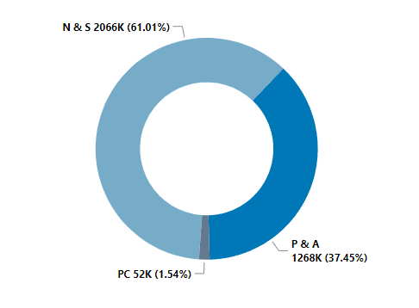
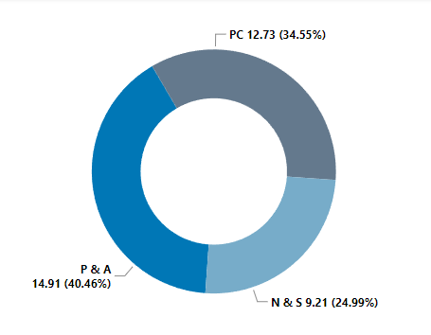
Total Quantity Sold
Total Gross_Sales
In PC division quantities sold are comparatively lower than other two division but PC division better Gross_sales than other divisions

Slide 14
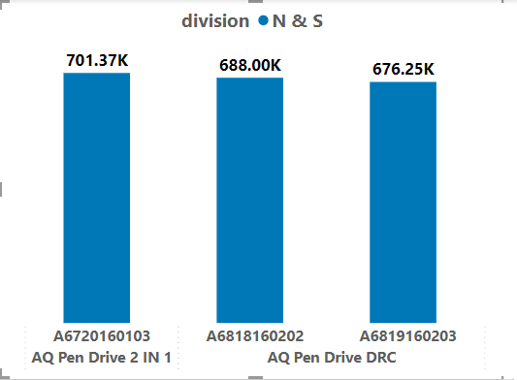
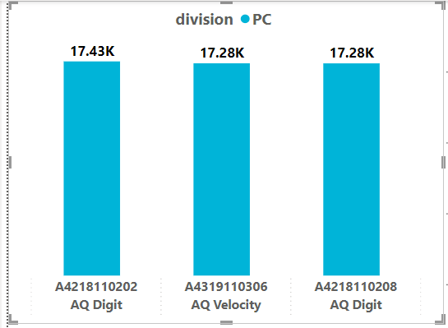
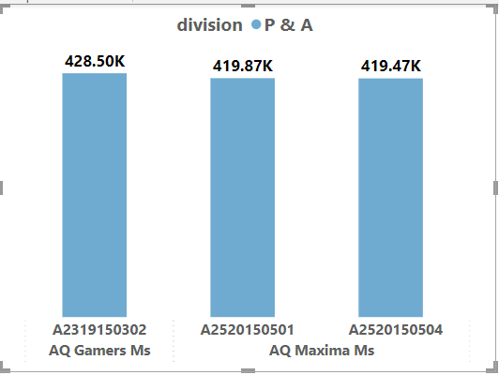
Premium
Plus
Premium
Standard 2
Standard 1
Plus 2
Standard Blue
Plus Red
Premium Misty Green

Slide 15
Queries
For Ad-hoc Requests

Slide 16
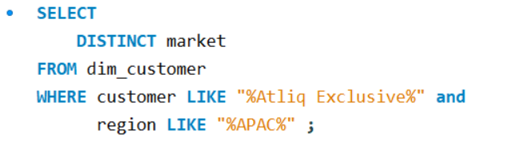
1. Provide the list of markets in which customer "Atliq Exclusive" operates its business in the APAC region.

Slide 17
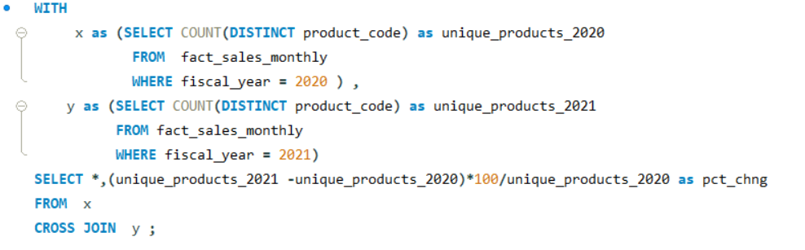
2. What is the percentage of unique product increase in 2021 vs. 2020? The final output contains these fields, unique_products_2020 unique_products_2021 percentage_chg

Slide 18
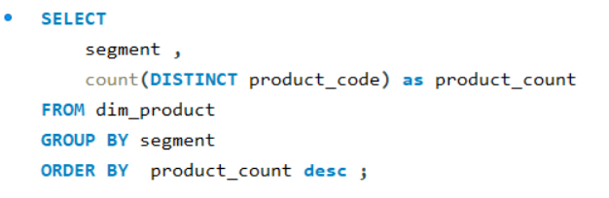
3. Provide a report with all the unique product counts for each segment and sort them in descending order of
product counts. The final output contains 2 fields, segment product_count

Slide 19
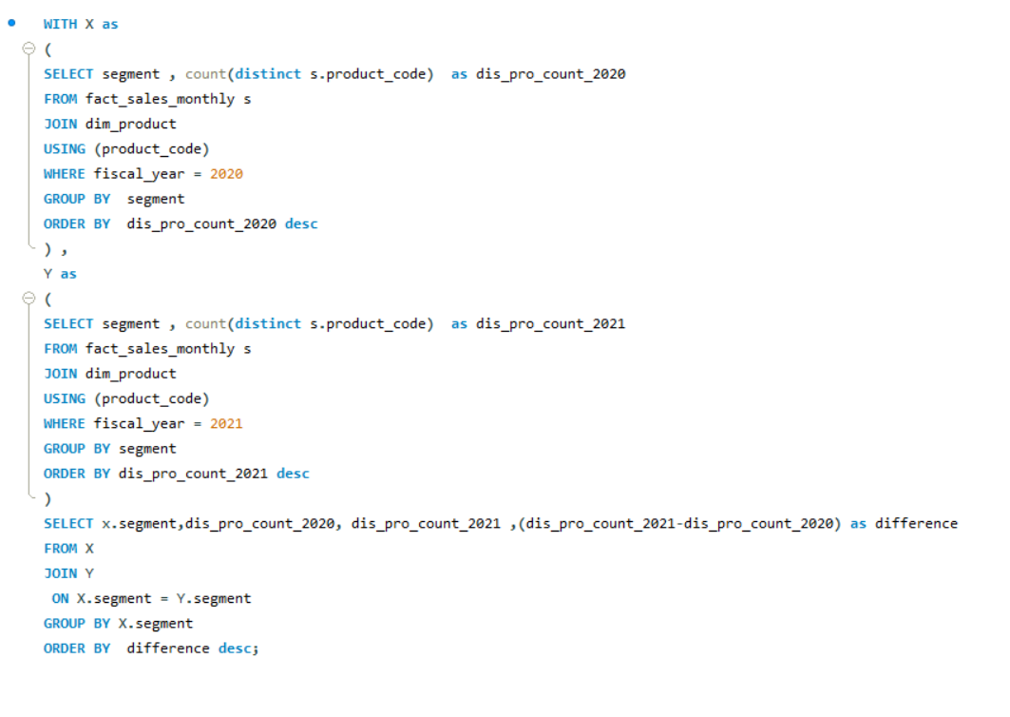
4. Follow-up: Which segment had the most increase in unique products in 2021 vs 2020? The final output contains these fields, segment product_count_2020 product_count_2021 difference

Slide 20
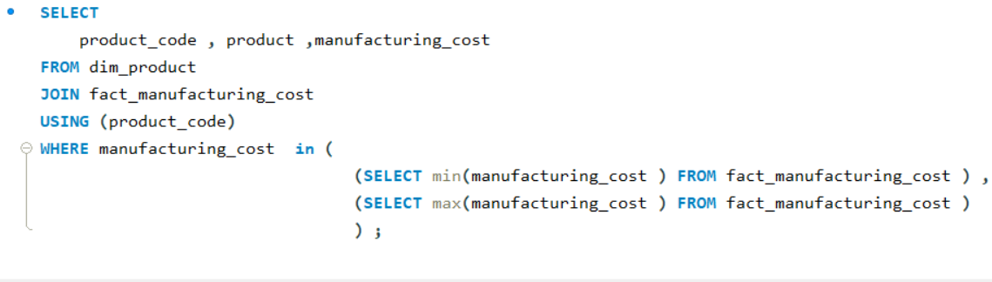
5 . Get the products that have the highest and lowest manufacturing costs. The final output should contain these fields, product_code product manufacturing_cost

Slide 21
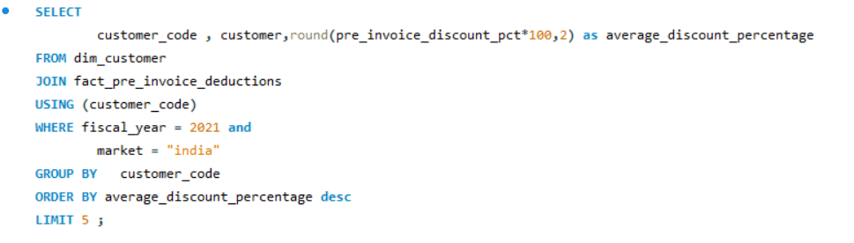
6. Generate a report which contains the top 5 customers who received an average high pre_invoice_discount_pct for the fiscal year 2021 and in the Indian market. The final output contains these fields, customer_code customer average_discount_percentage

Slide 22
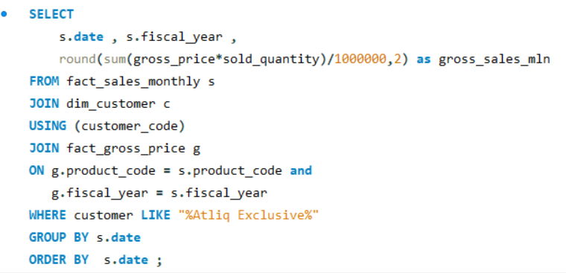
7. Get the complete report of the Gross sales amount for the customer “Atliq Exclusive” for each month. This analysis helps to get an idea of low and high-performing months and take strategic decisions. The final report contains these columns: Month Year Gross sales Amount

Slide 23
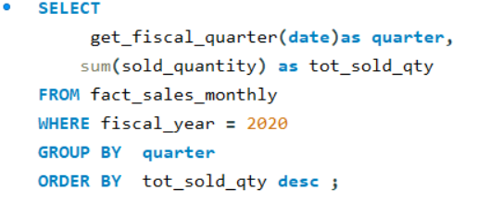
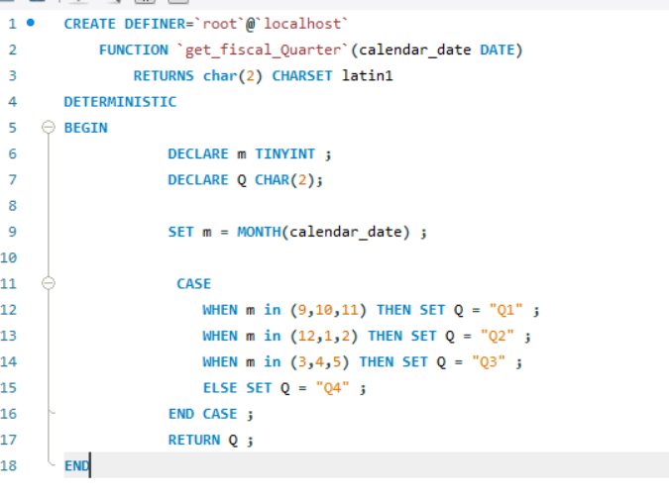
8. In which quarter of 2020, got the maximum total_sold_quantity? The final output contains these fields sorted by the total_sold_quantity, Quarter total_sold_quantity

Slide 24
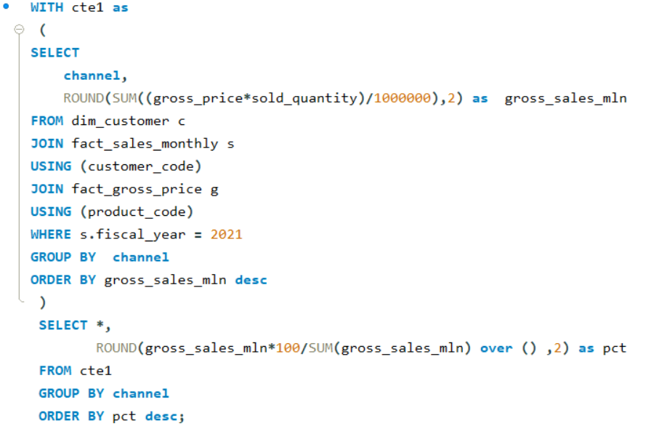
9. Which channel helped to bring more gross sales in the fiscal year 2021 and the percentage of contribution? The final output contains these fields, channel gross_sales_mln percentage

Slide 25
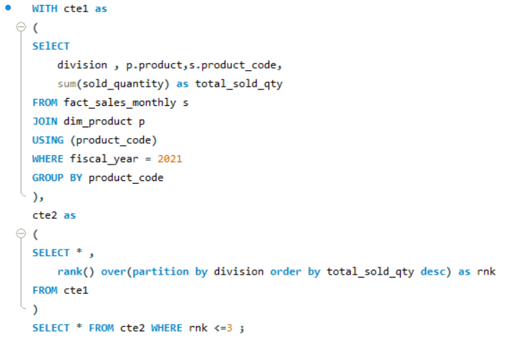
10. Get the Top 3 products in each division that have a high total_sold_quantity in the fiscal_year 2021? The final output contains these fields, division product_code codebasics.io product total_sold_quantity rank_order

